Slide 1

SMART INDIA HACKATHON 2026
ROBORELIEF – FUTURE OF DISASTER
Problem Statement ID – SIH26178
Problem Statement Title- A resilient, AI-powered environmental monitoring network that provides early detection, localized intelligence, and actionable alerts for floods, forest fires, pollution events, and other environmental hazards common in India, enabling authorities and communities to shift from reactive disaster response to proactive risk prevention.
Theme- DISASTER MANAGEMENT
PS Category- HARDWARE
Team ID-
Team Name - INNOVATRIX

Slide 2

IDEA TITLE
INNOVATRIX
AUTONOMOUS DISASTER DETECTION AND RESPONSE SYSTEM
Natural disasters such as earthquakes, landslides, floods and forest fires can occur suddenly and cause severe damage.
Early detection and rapid response are essential to reduce casualties and protect rescue personnel.
Black Box: Integrates multiple ground sensors to continuously monitor disaster-prone areas.
Central Processing: Analyzes sensor data and identifies abnormal conditions.
Autonomous Rover: Automatically deployed to the affected zone for real-time ground surveillance.
Uniqueness:
Combines early detection + automatic response + real-time field intelligence with minimal human intervention.

Slide 3
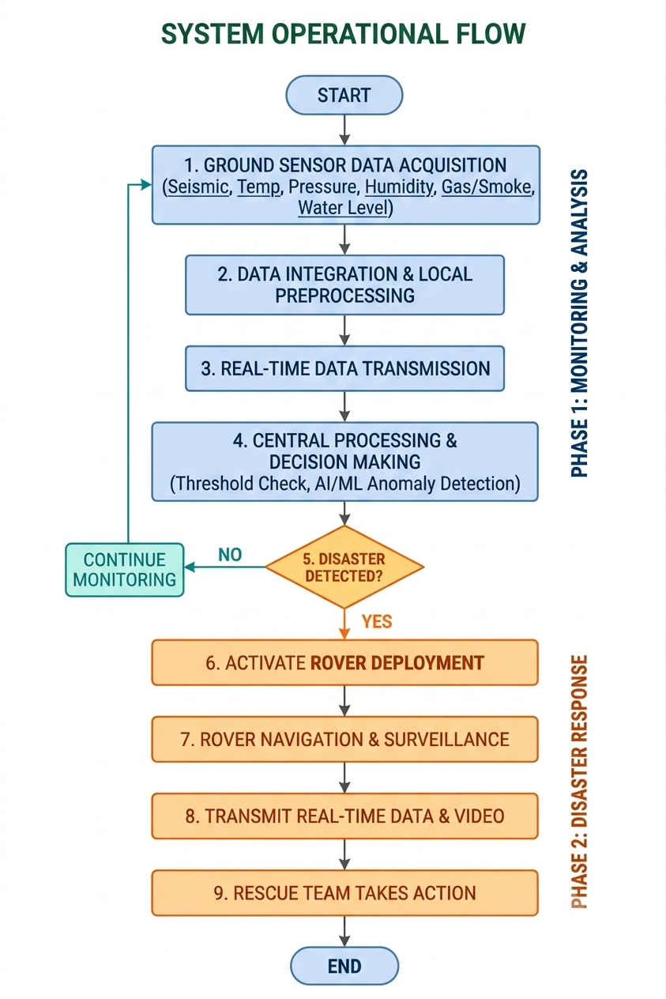
TECHNICAL APPROACH
INNOVATRIX
Black Box – Disaster Detection
ESP32 – Sensor data acquisition & communication
MPU6050 – Vibration / motion detection
DHT11 – Temperature & humidity monitoring
BMP280 – Atmospheric pressure monitoring
MQ-2 Gas Sensor – Smoke / combustible gas detection
Water Level Sensor – Flood / rising water detection
Central Processing
Raspberry Pi 4 – Data processing, decision making & alert generation
micro-ROS / Wireless Communication – ESP32 ↔️ Raspberry Pi data transfer
Autonomous Rover
Raspberry Pi / ESP32 – Rover control
Camera – Live visual surveillance
Ultrasonic Sensor / LiDAR – Obstacle detection
GPS Module – Location tracking
Motor Driver + DC Motors – Rover movement

Slide 4
FEASIBILITY AND VIABILITY
INNOVATRIX
FEASIBILITY
VIABILITY
Uses readily available components such as ESP32, Raspberry Pi and sensors.
Low-cost and modular hardware makes prototyping practical.
Black Box can operate with low power for continuous monitoring.
Autonomous rover can be developed using existing robotic platforms.
Wireless communication enables real-time data transmission.
Can be deployed in multiple disaster-prone areas.
Modular design allows additional sensors for different disasters.
Reduces human exposure to hazardous environments.
Continuous monitoring enables early warning and faster response.
Scalable solution with potential for large-scale disaster management.

Slide 5
IMPACT AND BENEFITS
INNOVATRIX
🚨 Early disaster warning through continuous sensor monitoring.
⚡ Faster emergency response by automatically triggering the rover.
🛡️ Improves rescuer safety by reducing the need for immediate human entry.
📡 Real-time situational awareness through live sensor data and video.
🤖 Autonomous operation with minimal human intervention.
🌐 24/7 monitoring of disaster-prone and remote areas.
🔍 Ground-level damage assessment before rescue teams arrive.
💰 Cost-effective and scalable for deployment across multiple locations.
🌱 Adaptable to multiple disasters such as earthquakes, floods, landslides and fires.
📊 Data-driven decision making helps authorities plan rescue operations effectively.
❤️ Potential to save lives and reduce property damage through faster and informed action.
📍 Accurate location tracking of the rover and affected areas.

Slide 6
RESEARCH AND REFERENCES
INNOVATRIX
Research on IoT-based disaster monitoring systems.
Studies on seismic and environmental sensing for early warning.
Research on autonomous rover navigation and disaster robotics.
Wireless Sensor Networks (WSN) for real-time environmental monitoring.
Edge/Cloud computing for rapid disaster-data processing.
Government of India / NDMA guidelines on disaster management.

